Slide 1
Scaling with Traditional Databases
Pravin Y Pawar

Slide 2
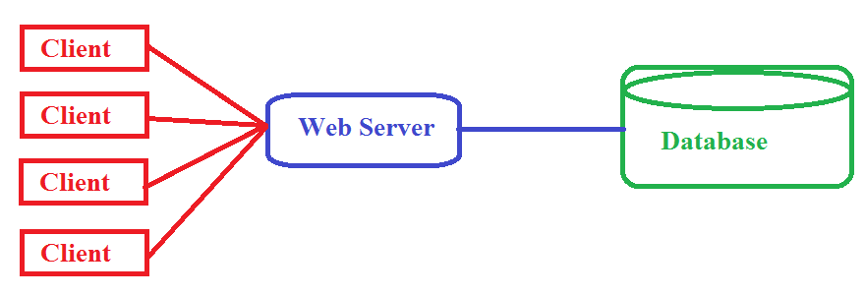
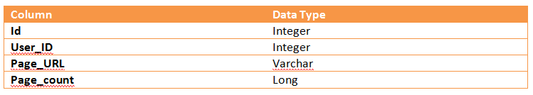
Web Analytics Application
Example Analytics Application
Designing an application to monitor the page hits for a portal
Every time a user visiting a portal page in browser, the server side keeps track of that visit
Maintains a simple database table that holds information about each page hit
If user visits the same page again, the page hit count is increased by one
Uses this information for doing analysis of popular pages among the users
Source : Adapted from Big Data by Nathan Marz

Slide 3
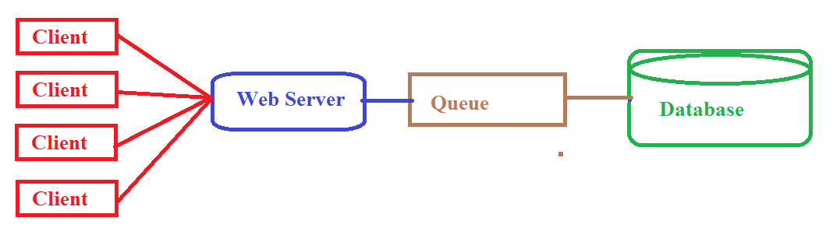
Scaling with intermediate layer
Using a queue
Portal is very popular, lot of users visiting it
Many users are concurrently visiting the pages of portal
Every time a page is visited, database needs to be updated to keep track of this visit
Database write is heavy operation
Database write is now a bottleneck
Solution
Use an intermediate queue between the web server and database
Queue will hold messages
Message will not be lost

Slide 4
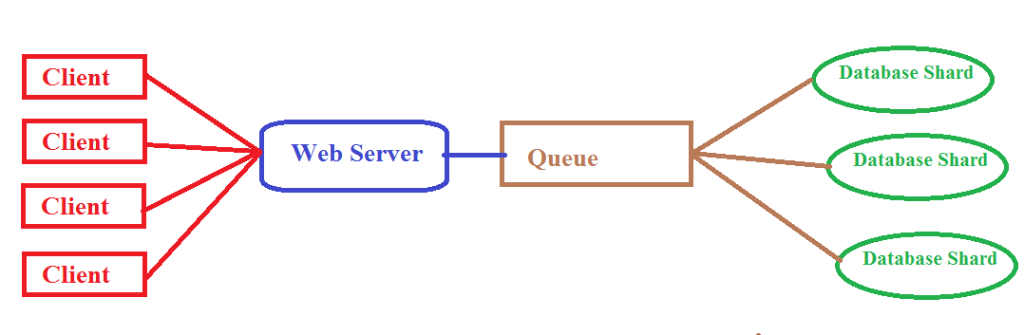
Scaling with Database Partitions
Using Database shards
Application is too popular
Users are using it very heavily, increasing the load on application
Maintaining the page view count is becoming difficult even with queue
Solution
Use database partitions
Data is divided into partitions which are hosted on multiple machines
Database writes are parallelized
Scalability increasing
Also complexity increasing

Slide 5
Issues Begins
Bottlenecks
Disks are prone to failure, hence partition can be inaccessible
Complicated to manage many number of shards
Repartitioning is again required when load increased
More buggy application code as complexity increasing
Difficult to retrieve from the mistakes done either by application code or humans

Slide 6
Rise of Big Data Systems
How it helps
Main issue with traditional data processing applications
Hard to make them scalable
Hard to keep them simple
Because everything is managed by application code
Which is more prone to mistakes due to buggy implementations
New edge systems aka Big Data Systems
Handles high data volume, at very fast rate coming from variety of sources
Systems aware about the distributed nature, hence capable of working with each other
Application does need to bother about common issues like sharding, replication etc
Scalability is achieved by horizontal scaling – just add new machines
Developers more focused on application logic rather than maintaining the environment

Slide 7
Thank You!
In our next session: Big Data Systems

